Slide 1

Deployment
Linux server on Digital Ocean droplet
MySql server for database server
Git & github

Slide 2
Before we start
Apply for at student account on github
(use your cphbusiness email)
to get free account on Digital Ocean:
https://education.github.com/pack

Slide 3
Agenda
Gennemgang fra sidste uge
Eval af modul 1
What does an operating system do
Practical stuff
Connect with Linux
Create users
Log in
Copy files up / down
Move files around (mv and cp)
Create catalogs
Rights (root, admin, user - rwx - sudo)
Standard in and out, piping, grep

Slide 4
Evaluering af modul 1
Har i lært noget i modul 1 i synes var spændende?
Er I blevet tilstrækkeligt udfordret?
Har I fået feedback på jeres arbejde som I kunne bruge til noget?
Har I kunnet arbejde sammen to og to?
Har I kunnet omsætte teori (fra net, mandag, stackoverflow) til kørende kode?
Har opgaverne været til at gå til?
Hvad skal vi specielt forbedre næste modul?

Slide 5
Git bash
We are going to use git from the prompt later on anyways, so we will use this tool to connect to our digitalocean linux from windows.
Mac users can connect using the build-in command prompt (named “Terminal”). Mac is a unix machine from the beginning.

Slide 6
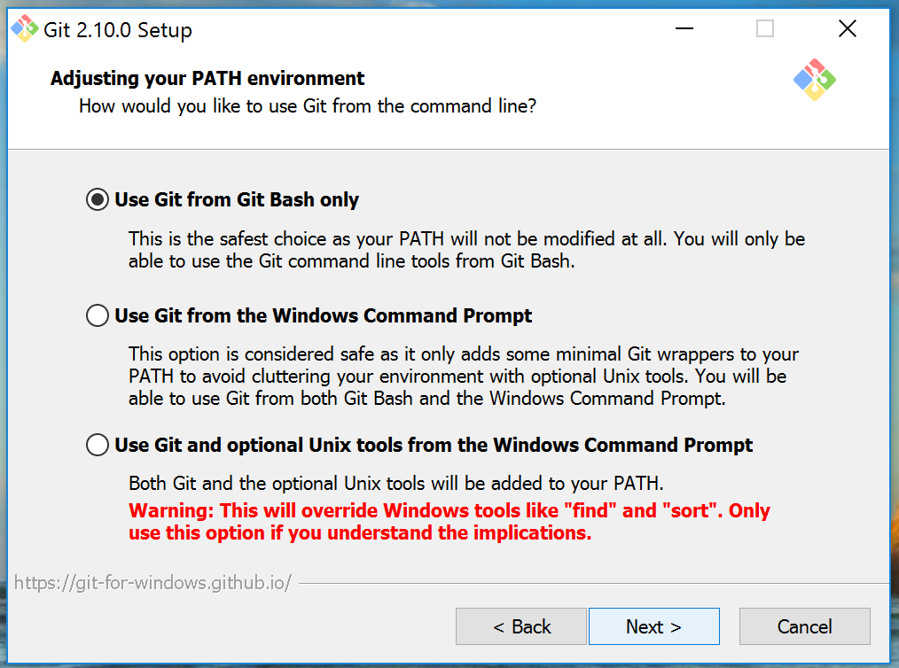
Installing GIT bash- Windows
Git (and in particular git-bash) can be installed from:
https://git-scm.com/download
The installer will at one point ask:
I believe the rest of the options can
left as they are.
Note: Mac has the necessary programs build in as the mac is a unix machine

Slide 7
Command promt
working directory
ls (LiSt)
ls –a (list all (også de filer der starter med “.”)
ls –l (list long (flere oplysninger pr. fil)
ls –al (begge dele)
pwd (print working directory – hvor er vi)
cd (change directory)
special directories
this directory “.”
root directory “/”
above directory “..”
user home “~”
show contents of file: “less <filename>”

Slide 8
Exercise
Go to the directory of your IntelliJ project from first week
From there go to the directory where the html files were stored
Look at the contents of one of the html files

Slide 9

Java program fra kommando promt
IntelliJ genererer en ”jar” fil når I oversætter jeres program.
Vælg ”clean and build” ( ) for at lave jar filen.
Man kan køre en java jar-fil fra kommando prompt:
java -cp ‹sti›/foo.jar full.package.name.ClassName
f.eks.
java -cp ./Modul1Network-0.1.jar webserver.dat.sem2.ServerMain
bemærk hvis fil-stien til jar filen er
/Users/kasper/mitintellij/modul1/Modul1Network-0.1.jar
kan man også skrive:
java -cp /Users/kasper/mitintellij/modul1/Modul1Network-0.1.jar webserver.dat.sem2.ServerMain

Slide 10
log in på en linux server
Kasper’s lille linux server 46.101.253.149
der er en bruger der hedder ”sem2dat”
med password (skrives på tavlen)
ssh sem2dat@46.101.253.149
du kan fra kommando-promt på din laptop logge på kaspers maskine og få en kommando promt

Slide 11
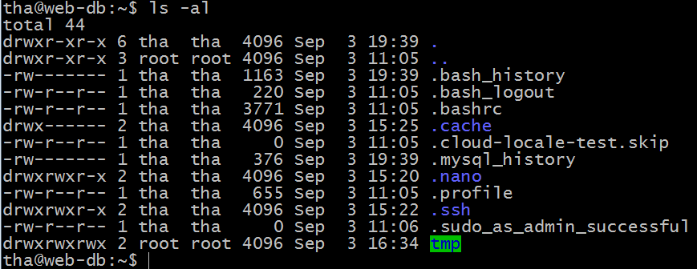
Øvelse
Check om i har fået github student pack
Opret et SSH nøglepar
Lav en droplet på Digital Ocean
Indsæt public key på D.O.
Åben Git bash fra laptop og SSH til server.
skriv command: ls -al fra home directory

Slide 12
Digital Ocean
Linux in the cloud

Slide 13
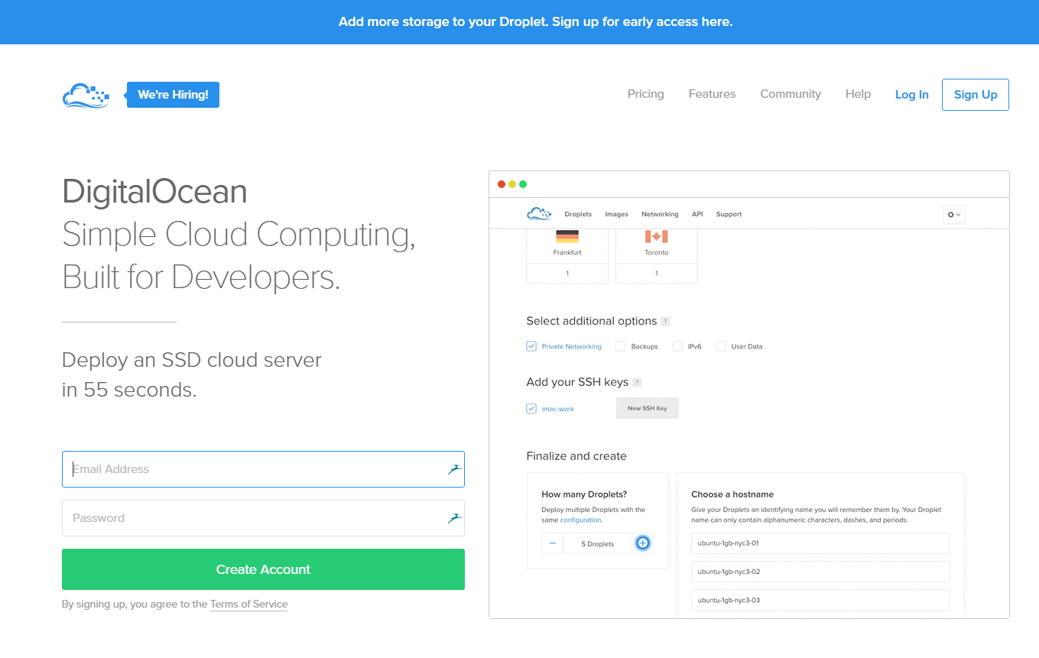
Digital Ocean
There are many providers which offer a Linux machine in the cloud.
For this set of exercises we recommend you as a group buy a 5$ month access to an Ubuntu Linux machine at Digital Ocean.
You will only need to work with what is called a Unix shell, and we will set up a server as part of the next three days.
One machine can have several users logged in at the same time, and the cheapest version should do just fine.

Slide 14
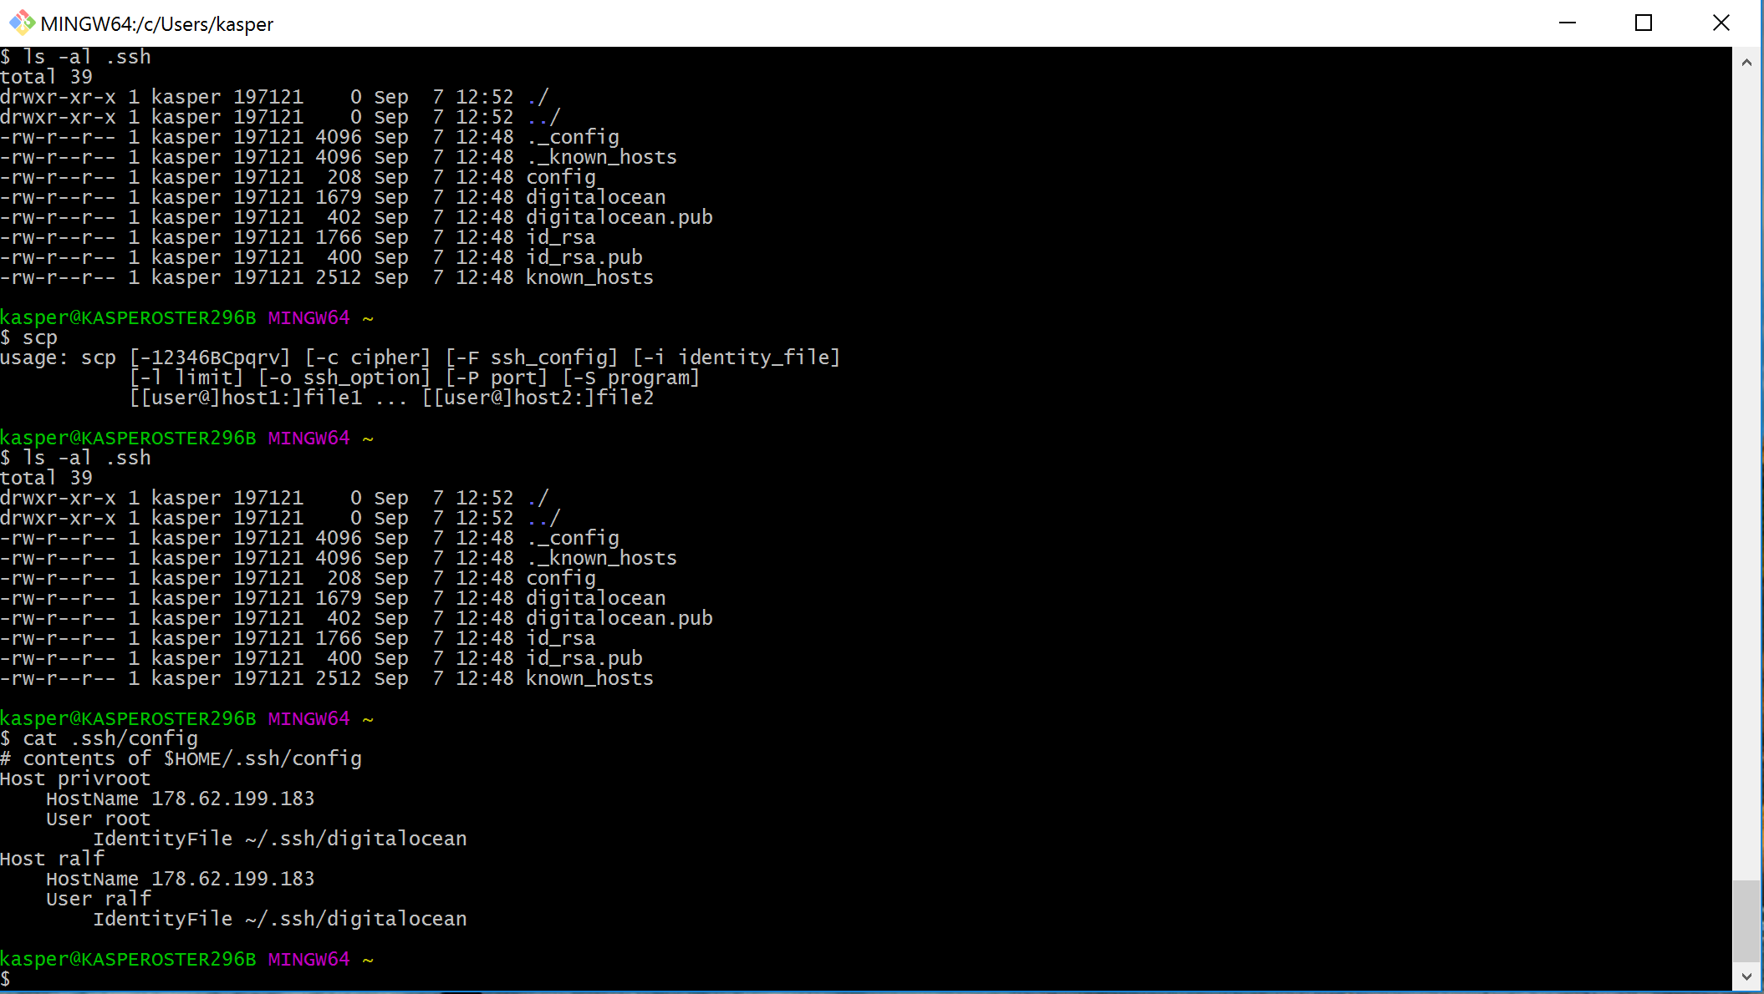


Connecting to a linux server
Connecting to a server using ssh is a two step procedure.
First you run the git-bash program to allow you to have a “shell” program to work on your own computer using a text-only interface
Second, you use the shell to connect to the digitalocean server – the command to do this is called ssh (secure shell).

Slide 15
Linux on Digital Ocean

Slide 16
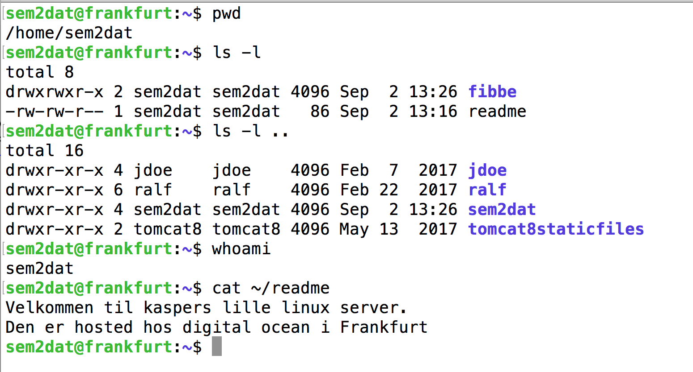
basic navigation
Print working directory
(where am I)
list files in current directory
-l is long listing
list files in directory above current directory
which username am I loggen in as
show contents of ~/readme

Slide 17
Directory Related Commands
cp – Copy of file - cp source_file destination_file
mv – Renaming - mv old_file new_file
rm – Delete – rm filename
cd – Change dir – cd~ (home dir) – cd- (last dir)
mkdir – Create directory - mkdir dirname
rmdir – Remove directory – rmdir dirname
pwd – print working directory - pwd

Slide 18
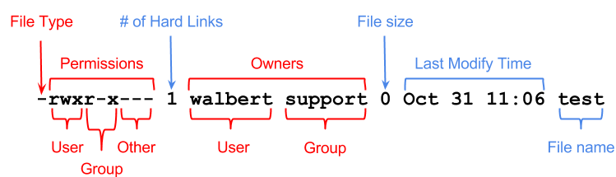
File permissions
If the command ls -l is given, a long list of file names is displayed. The first column in this list details the permissions applying to the file.
The chmod command changes the
permission on a given file or directory.
chmod sets permissions in two ways.
Using symbols
Using octal values
Octal | Symbol | Permission
0 | --- | No Permissions
1 | --x | Execute
2 | -w- | Write
3 | -wx | Write and Execute
4 | r-- | Read
5 | r-x | Read and Execute
6 | rw- | Read and Write
7 | rwx | Read, Write, and Execute

Slide 19
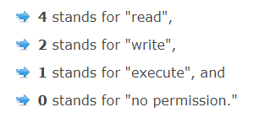
User and group
Authorization by user or by group
Add user to group: useradd -G {group-name} username
Change rights on directory: chmod -R <permissionsettings> <dirname>
permissionsettings are the read-write-execute on user-group-others.
Example: chmod -R 777 /home/tha/tmp

Slide 20
Subdirectories of the root directory
Directory | Content
/bin | Common programs, shared by the system, the system administrator and the users.
/boot | The startup files and the kernel, vmlinuz. In some recent distributions also grub data. Grub is the GRand Unified Boot loader and is an attempt to get rid of the many different boot-loaders we know today.
/dev | Contains references to all the CPU peripheral hardware, which are represented as files with special properties.
/etc | Most important system configuration files are in /etc, this directory contains data similar to those in the Control Panel in Windows
/home | Home directories of the common users.
/initrd | (on some distributions) Information for booting. Do not remove!
/lib | Library files, includes files for all kinds of programs needed by the system and the users.
/lost+found | Every partition has a lost+found in its upper directory. Files that were saved during failures are here.
/misc | For miscellaneous purposes.
/mnt | Standard mount point for external file systems, e.g. a CD-ROM or a digital camera.
/net | Standard mount point for entire remote file systems
/opt | Typically contains extra and third party software.
/proc | A virtual file system containing information about system resources. More information about the meaning of the files in proc is obtained by entering the command man proc in a terminal window. The file proc.txt discusses the virtual file system in detail.
/root | The administrative user's home directory. Mind the difference between /, the root directory and /root, the home directory of the root user.
/sbin | Programs for use by the system and the system administrator.
/tmp | Temporary space for use by the system, cleaned upon reboot, so don't use this for saving any work!
/usr | Programs, libraries, documentation etc. for all user-related programs.
/var | Storage for all variable files and temporary files created by users, such as log files, the mail queue, the print spooler area, space for temporary storage of files downloaded from the Internet, or to keep an image of a CD before burning it.

Slide 21
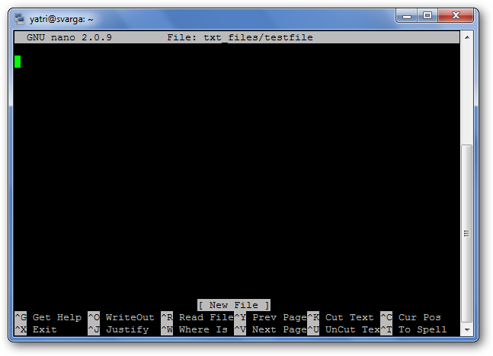
Nano Editor
nano is a text editor for Unix-like computing systems or operating environments using a command line interface.
It can be a little tricky to use at first.
Go here for a quick introduction: how to nano
Basic commands:
Open text file in nano:
nano /path/to/filename
Ctrl + G:
Help menu
Ctrl + O:
save and exit nano
Ctrl + X
exit current operation

Slide 22
Operativ systemets opgaver

Slide 23
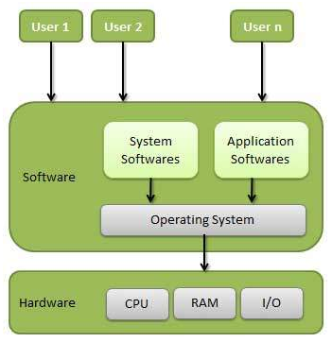
Operating systems I
Computer system can be divided into four components
Hardware – provides basic computing resources
CPU, memory, I/O devices
Operating system
Controls and coordinates use of hardware among various applications and users
Application programs – define the ways in which the system resources are used to solve the computing problems of the users
Word processors, compilers, web browsers, database systems, video games
Users
People, machines, other computers

Slide 24
Operating Systems II
One set of operating-system services provides functions that are helpful to the user:
User interface - Almost all operating systems have a user interface (UI)
Varies between Command-Line (CLI), Graphics User Interface (GUI)
Program execution - The system must be able to load a program into memory and to run that program, end execute, either normally or abnormally (indicating error)
I/O operations - A running program may require I/O, which may involve a file or an I/O device.
File-system manipulation - The file system is of particular interest. Obviously, programs need to read and write files and directories, create and delete them, search them, list file Information, permission management.

Slide 25
SSH og nøgler
Linux in the cloud

Slide 26
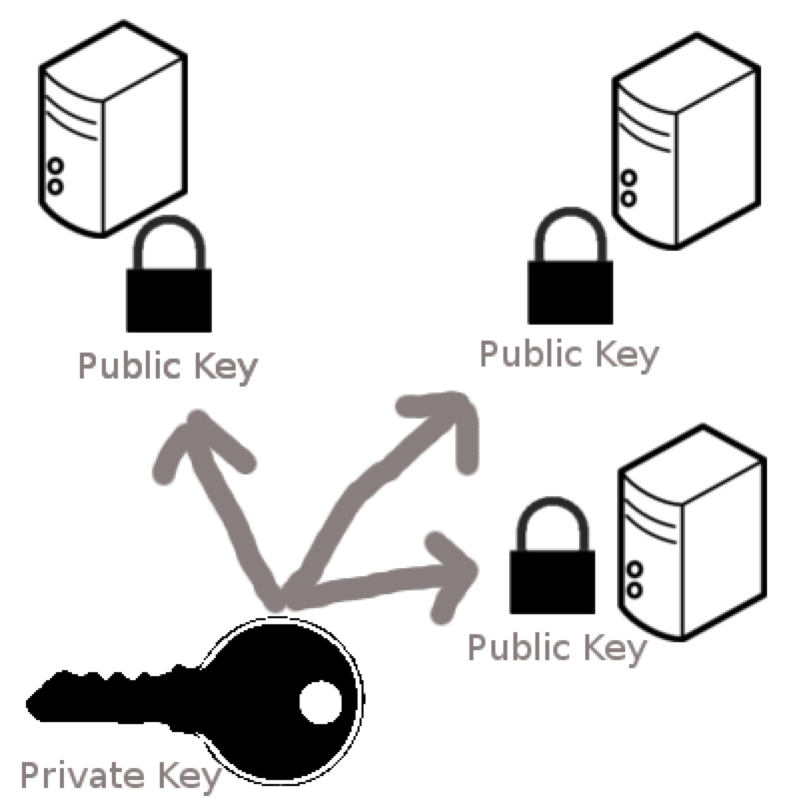

Public and private key
You store the private key on your computer
The typical place is in your root directory in the folder named “.ssh”.
The private key is normally called id_rsa, and the public one called id_rsa.pub
The public key is placed on the remote computer
The public key is placed in the .ssh/authorized_keys
You can place the public key on many computers

Slide 27
Lav nøglepar
I git-bash :
ssh-keygen
kommandoen vil spørge dig om hvor nøglen skal placeres
Du bør placere den i .ssh kataloget
Den vil forsøge at drille dig hvis du vælger noget andet end standard.
Enter file in which to save the key (/Users/kasper/.ssh/id_rsa): /Users/kasper/.ssh/id_digitalocean
Hvis du vil bruge et andet navn end standard:
Du skal enten give hele stien inklusiv navn
eller have working directory til ~/.ssh

Slide 28
Logging in using ssh keys
From git-bash
ssh username@ip-address
If you saved your key in a file other than id_rsa, then you must tell the file name with the key (using –i):
ssh –i filepathofprivatekey username@ip-address

Slide 29
The ssh config file
If you are logging in and out of the server very often you get tired of remembering the ip-address number and other parameters
You can have a file named config in the .ssh folder
Having an ssh file allows us to log in as:
ssh ralfpriv
Host ralfpriv HostName 95.85.40.235 User ralf IdentityFile ~/.ssh/digitalocean

Slide 30
Encryption principle of SSH
Outside of our usage of SSH – just for background
A message encrypted using a private key can be decrypted by a public key
A message encrypted using a public key can be decrypted using a private key
Assume two parties A and B each has their private key, and the public key of the other.
1.How can A send a message to B which only B can read?
2.How can B be sure the message is from A?

Slide 31
Git & Github
Første workshop (beregnet til torsdag)

Slide 32
Basale begreber i git
Workspace
Tænk på et IntelliJ projekt som et eksempel.
Snapshot
Tænk ”zip af projekt”
Repository
Tænk et særligt katalog hvor man gemmer sine snapshots
Et lokalt repository som er på din egen maskine.
Et delt repository som ligger på en server, som alle i teamet kan dele.
Staging area (også kaldet index)
Staging area kan vel her oversættes til byggepladsen.

Slide 33
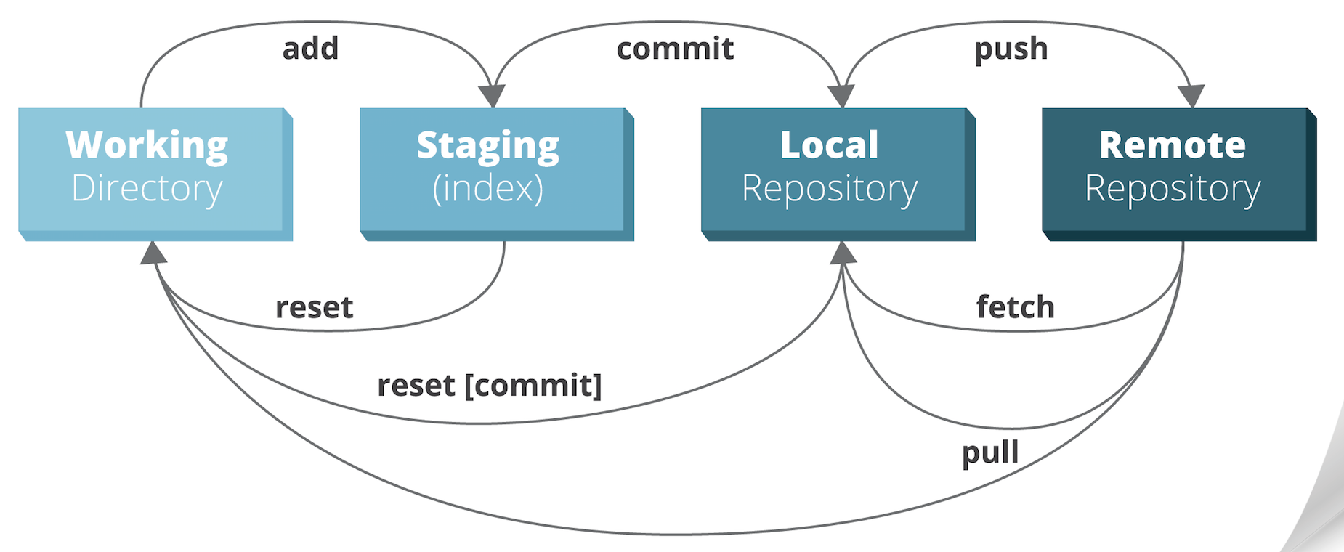
Git kommandoer
Der er en kommando-linje kommando der hedder ”git”.
Jeg vil opfordre jer til at bruge kommando-linjen til git indtil I er 100% med på git

Slide 34
Husk at I stadig kan gøre som før!
Der er en god chance for at I får lavet kludder i jeres git.
Måden kan redder situationen på er:
Finder en der har et projekt, der er det ”rigtige” – Kaj har det!
Sletter det ”døde” projekt på github
Alle andre end Kaj sletter deres projekter (eller zipper og gemmer dem)
Kaj opretter et nyt git projekt, som beskrevet i noterne
De andre kloner dette projekt
Dette er langt langt nemmere for studenter-projekter end det I kan finde på stackoverflow
De løsninger der foreslås på stackoverflow skyldes, at det er vitalt for en virksomhed at bibeholde deres git repository og dets historik

